Slide 1
Unit 2
Linear Filters
Edge Detection
Textures

Slide 3
Unit 2 syllabus
Linear Filters: Linear Filters and Convolution
Shift Invariant Linear Systems.
Spatial Frequency and Fourier Transforms
Sampling and Aliasing
Filters as Templates
Edge Detection:Noise ,
Estimating Derivatives
Detecting Edges
Texture:Representing Texture
Analysis (and Synthesis )using oriented pyramids
Application:Synthesis by Sampling Local Models
Shape from Texture

Slide 4
Linear Filters
Introduction
Linear filtering of an image is accomplished through an operation called convolution. Convolution is a neighborhood operation in which each output pixel is the weighted sum of neighboring input pixels. The matrix of weights is called the convolution kernel, also known as the filter.

Slide 5
Linear Filters
Many important effects can be modelled with a quite simple model.
Construct a new array, the same size as the image.
Fill each location of this new array with a weighted sum of the pixel values from the locations surrounding the corresponding location in the image, using the same set of weights each time.
Different sets of weights could be used to represent different processes. One example is computing a local average, taken over a fixed region.
We could average all pixels within a 2k + 1 × 2k + 1 block of the pixel of interest. For an input image F, this gives an output

Slide 6
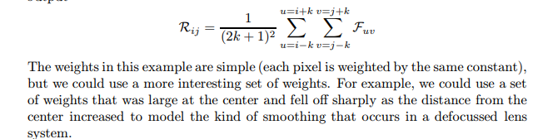

Slide 7
Contd..
Whatever the weights chosen, the output of this procedure is shift-invariant — meaning that the value of the output depends on the pattern in an image neighbourhood, rather than the position of the neighbourhood — and linear — meaning that
the output for the sum of two images is the same as the sum of the outputs obtained for the images separately. The procedure itself is known as linear filtering

Slide 8

Convolution
The pattern of weights used for a linear filter is usually referred to as the kernel of the filter. The process of applying the filter is usually referred to as convolution
given a filter kernel H, the convolution of the kernel with image F is an image R. The i, j’th component of R is given by:

Slide 9
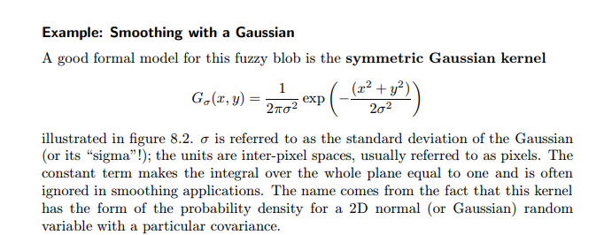
Convolution

Slide 10
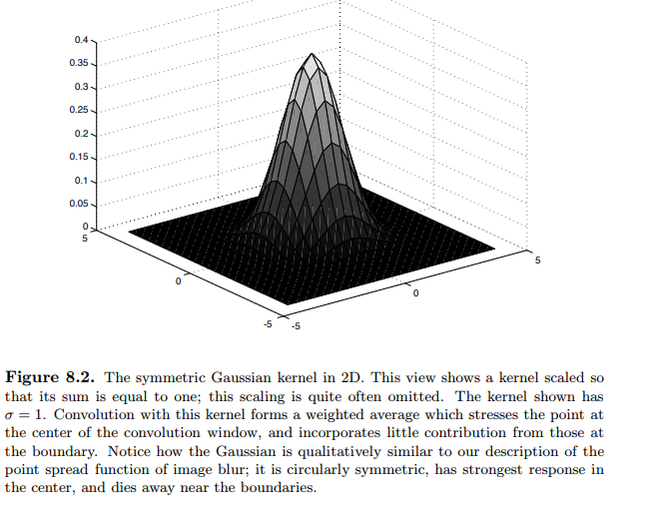
Convolution

Slide 11
Convolution
we can ensure that the requirement that a pixel look like its neighbours is less strongly imposed for distant neighbours.
A qualitative analysis gives:
• if standard deviation of the Gaussian is very small — say smaller than one pixel — the smoothing will have very little effect, because the weights for all pixels off the center will be very small;
• for a larger standard deviation, the neighbouring pixels will have larger weights in the weighted average, which means in turn that the average will be strongly biased toward a consensus of the neighbours — this will be a good estimate of a pixel’s value, and the noise will largely disappear, at the cost of some blurring;
• finally, a kernel that has very large standard deviation will cause much of the image detail to disappear along with the noise.

Slide 12
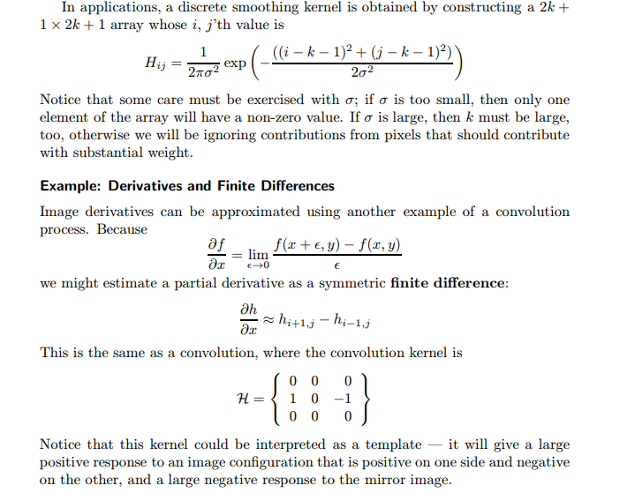
Convolution

Slide 14
2.Shift Invariant Linear Systems.
Superposition: we expect that R(f + g) = R(f) + R(g) that is, the response to the sum of stimuli is the sum of the individual responses.
• Scaling: the response to a zero input is zero. Taken with superposition, we have that the response to a scaled stimulus is a scaled version of the response to the original stimulus, i.e. R(kf) = kR(f) A device that exihibits superposition and scaling is linear.
• Shift invariance: in a shift invariant system, the response to a translated stimulus is just a translation of the response to the stimulus.
This means that, for example, if a view of a small light aimed at the center of the camera is a small bright blob, then if the light is moved to the periphery, we should see the same small bright blob, only translated.

Slide 15
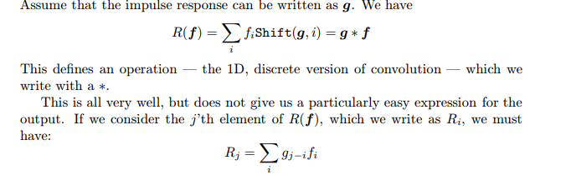
2.Shift Invariant Linear Systems.
Discrete Convolution :1D

Slide 16
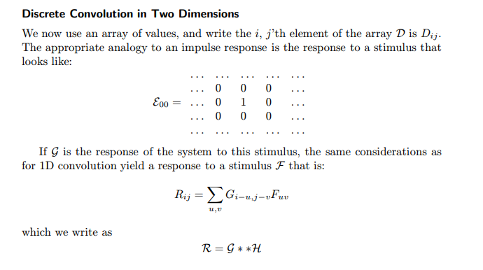
2.Shift Invariant Linear Systems.
Discrete Convolution :

Slide 17
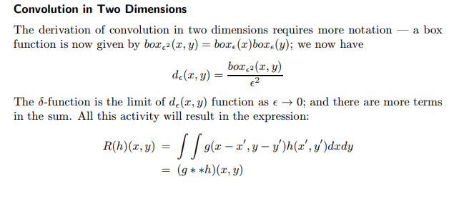
2.Shift Invariant Linear Systems.
Discrete Convolution :continous

Slide 18
2.Shift Invariant Linear Systems.
Edge Effects in Discrete Convolutions
Ignore these locations — this means that we report only values for which every required image location exists. This has the advantage of probity, but the disadvantage that the output is smaller than the input — repeated convolutions can cause the image to shrink quite drastically.
• Pad the image with constant values — this means that, as we look at output values closer to the edge of the image, the extent to which the output of the convolution depends on the image goes down. This is a convenient trick, because we can ensure that the image doesn’t shrink, but it has the disadvantage that it can create the appearance of substantial gradients near the boundary.
• Pad the image in some other way — for example, we might think of the image as a doubly periodic function, so that, if we have an n × m image, then column m + 1 — required for the purposes of convolution — would be the same as column m − 1. This can create the appearance of substantial second derivative values near the boundary

Slide 19
3. Spatial Frequency and Fourier Transforms
A signal g(x, y) an weighted sum of a very large (or infinite) number of very small (or infinitely small) box functions
This model emphasizes that a signal is an element of a vector space — the box functions form a convenient basis, and the weights are coefficients on this basis. We need a new technique to deal with two related problems, so far left open:
• while it is clear that a discrete image version cannot represent the full information in a signal, we have not yet indicated what is lost;
it is clear that we cannot shrink an image simply by taking every k’th pixel — this could turn a checkerboard image all white or all black — and we should like to know how to shrink an image safely

Slide 20
.
A change of basis.
We will change the basis to be a set of sinusoids, and represent the signal as an infinite weighted sum of an infinite number of sinusoids.
This means that fast changes in the signal will be obvious, because they will correspond to large amounts of high frequency sinusoids in the new basis

Slide 21
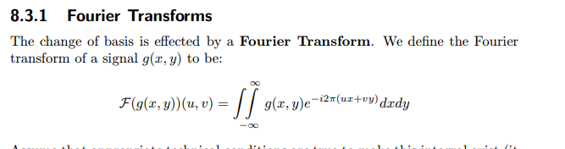
.

Slide 22
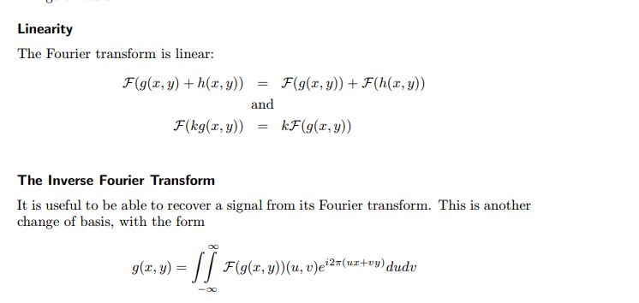

Slide 23
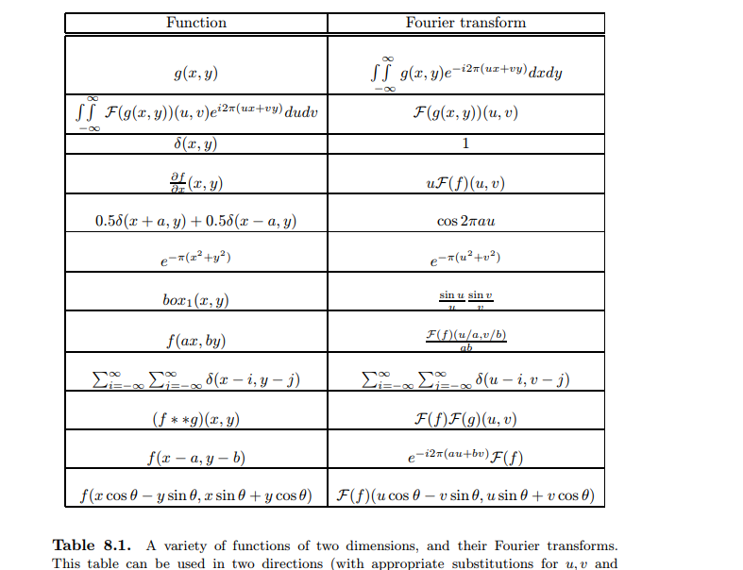
Fourier Transform pairs

Slide 24
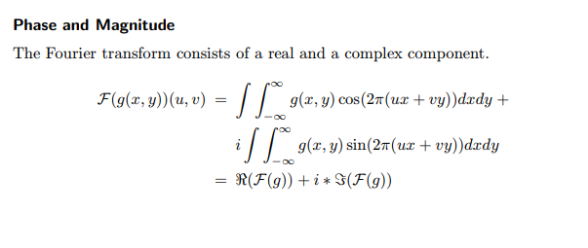
Fourier Transform pairs

Slide 25
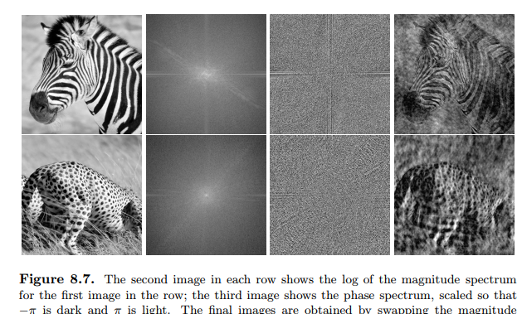
Fourier Transform pairs
Magnitude
Phase spectrum

Slide 26
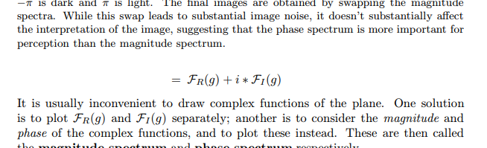

Slide 27
4.Sampling and Aliasing
The crucial reason to discuss Fourier transforms is to get some insight into the difference between discrete and continuous images.
Sampling
Passing from a continuous function — like the irradiance at the back of a camera system — to a collection of values on a discrete grid — like the pixel values reported by a camera — is referred to as sampling.

Slide 28
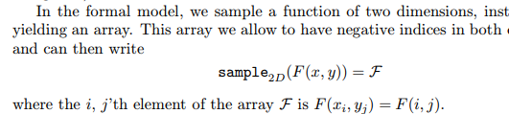
4.Sampling and Aliasing
Sampling in One Dimension
sample1D(f(x)) = f
Sampling in Two Dimensions

Slide 29
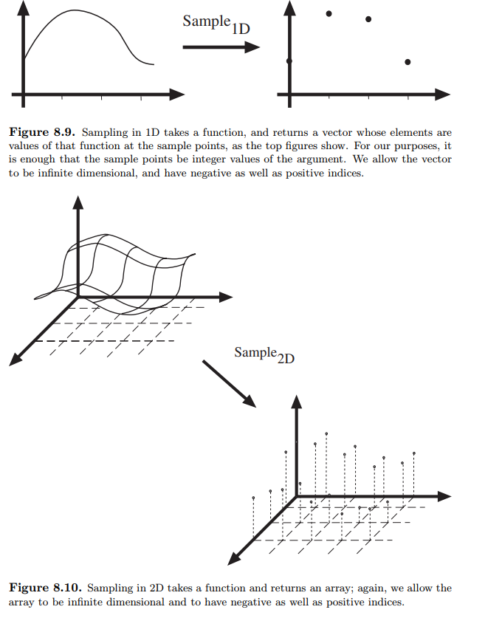
4.Sampling and Aliasing

Slide 30
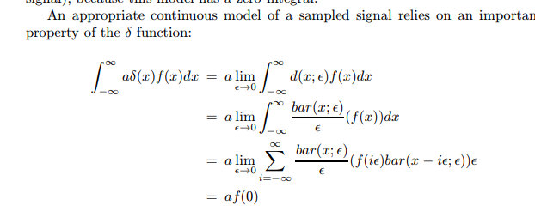
4.Sampling and Aliasing

Slide 31
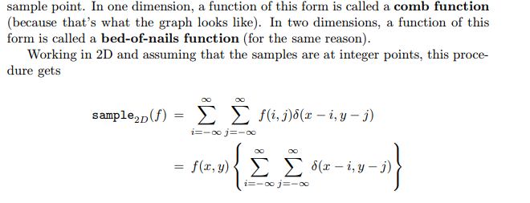
4.Sampling and Aliasing

Slide 32
Aliasing:
Sampling involves a loss of information. As this section will show, a signal that is sampled too slowly will be misrepresented by the samples; high spatial frequency components of the original signal will appear as low spatial frequency components in the sampled signal, an effect known as aliaising.

Slide 33
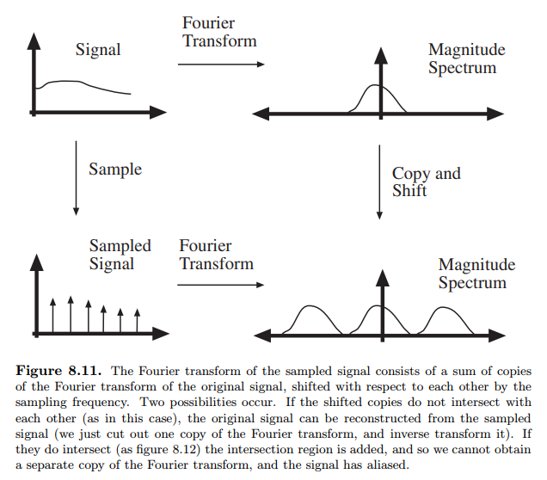

Slide 34
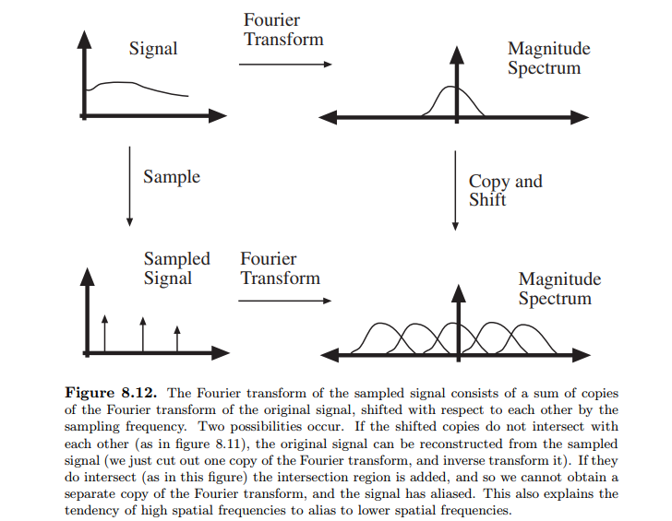

Slide 35
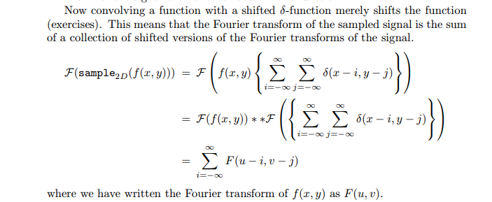
The fourier transform of a sampled signal

Slide 36
However, if the support regions do overlap, we will not be able to reconstruct the signal because we will not be able to determine the Fourier transform of the signal in the regions of overlap, where different copies of the Fourier transform will add.
This results in a characteristic effect, usually called aliasing, where high spatial frequencies appear to be low spatial frequencies (see figure 8.13 and exercises). Our argument also yields Nyquist’s theorem — the sampling frequency must be at least twice the highest frequency present for a signal to be reconstructed from a sampled version.

Slide 37
If we resample this signal, the copies will now have centers on the half-integer points in u, v space. This means that, to avoid aliasing, we need to apply a filter that strongly reduces the content of the original Fourier transform outside the range |u| < 1/2, |v| < 1/2.
The choice of Gaussian depends on the application; if σ is large, there is less aliasing (because the value of the kernel outside our range is very small), but in- formation is lost because the kernel is not flat within our range; similarly, if σ is small, less information is lost within the range, but aliasing can be more substantial.

Slide 38
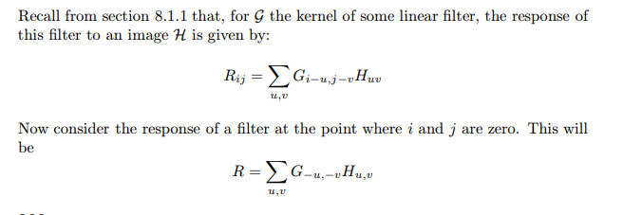
5.Filters as Templates
It is generally the case that filters that are intended to give a strong response to a pattern look like that pattern. This is a simple geometric result.
Convolution as a Dot Product

Slide 39
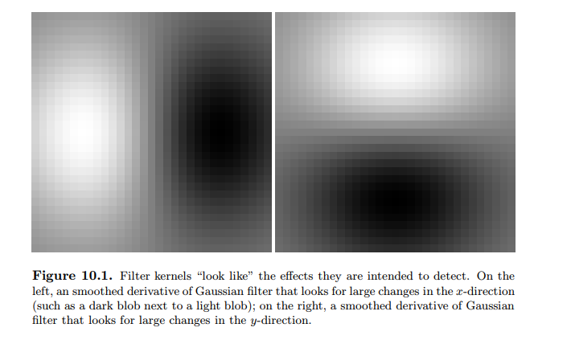
5.Filters as Templates
By inserting zeros as needed, we can ensure that these two vectors have the same dimension. Once this is done, the process of multiplying associated elements and summing is precisely the same as taking a dot-product.

Slide 40
5.Filters as Templates
Changing Basis
We can think of convolution as a dot-product between the image and a different vector (because we have moved the filter kernel to lie over some other point in the image). The new vector is obtained by rearranging the old one, so that the elements lie in the right components to make the sum work out. This means that, by convolving an image with a filter, we are representing the image on a new basis of the vector space of images — the basis given by the different shifted versions of the filter. The original basis elements were vectors with a zero in all slots except one. The new basis elements are shifted versions of a single pattern.
we choose a basis which consists of small, useful pattern components,without losing information

Slide 41
5.Filters as Templates
Technique: Normalised Correlation and Finding Patterns
By analogy with vectors, we are interested in the cosine of the angle between the filter vector and the image neighbourhood vector; this suggests computing the root sum of squares of the relevant image region (the image elements that would lie under the filter kernel) and dividing the response by that value
This yields a value that is large and positive when the image region looks like the filter kernel, and small and negative when the image region looks like a contrastreversed version of the filter kernel. This value could be squared if contrast reversal doesn’t matter. This is a cheap and effective method for finding patterns, often called normalised correlation.

Slide 42
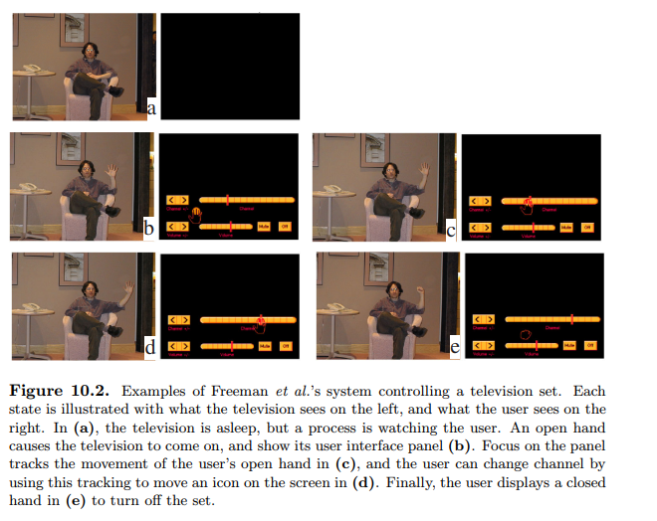
5.Filters as Templates
Technique: Normalised Correlation and Finding Patterns

Slide 43
.6Edge Detection

Slide 44
:Noise ,
Points in the image where brightness changes particularly sharply are often called edges or edge points
Noise
A primary problem in edge detection is image noise. This is because edge detectors are constructed to respond strongly to sharp changes; but one way to get sharp changes in an image is to add noise to the pixels
the term noise, we mean image measurements from which we do not know how to extract information, or from which we do not care to extract information; all the rest is signal.

Slide 45
Noise

Slide 46
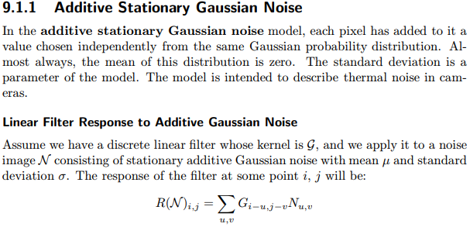
6.Noise ,

Slide 47
6Noise ,
differentiating a function is the same as multiplying its Fourier transform by a frequency variable; this means that the high spatial frequency components are heavily emphasized at the expense of the low frequency components. This is intuitively plausible — differentiating a function must set the constant component to zero, and the amplitude of the derivative of a sinusoid goes up with its frequency. Furthermore, this property is the reason we are interested in derivatives; we are discussing the derivative precisely because fast changes (which generate high spatial frequencies) have large derivatives

Slide 48
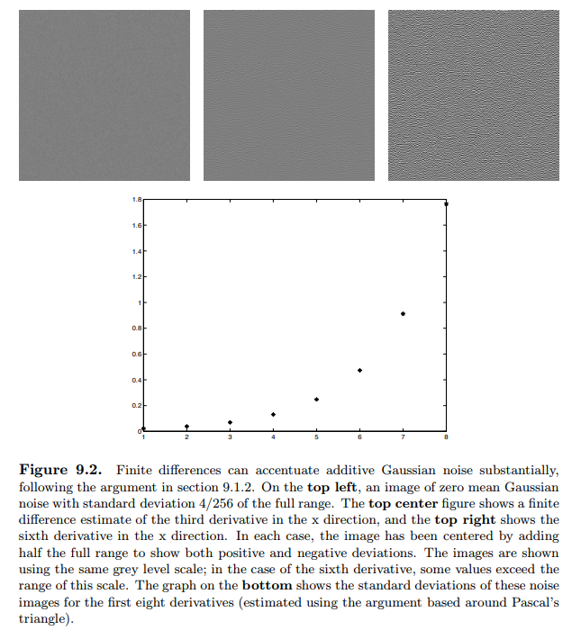
7. Edge Detection:Noise ,
Why Finite Differences Respond to Noise

Slide 49
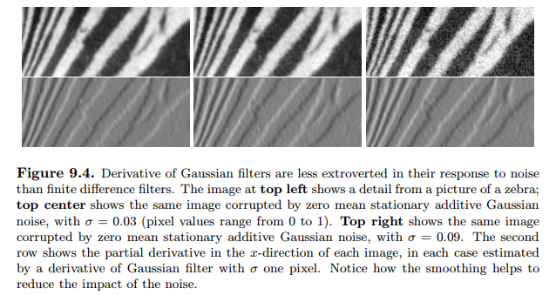
7. Estimating Derivatives

Slide 50
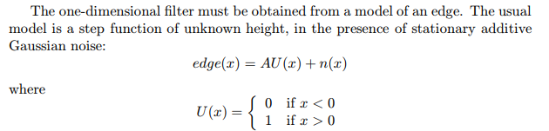
Choosing a Smoothing Filter

Slide 51
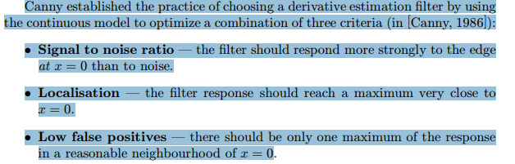
7. Estimating Derivatives
Choosing a Smoothing Filter
The choice of σ used in estimating the derivative is often called the scale of the smoothing. Scale has a substantial effect on the response of a derivative filter

Slide 52
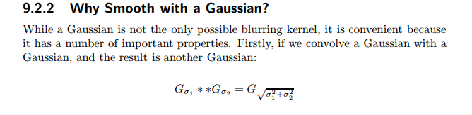

Slide 53
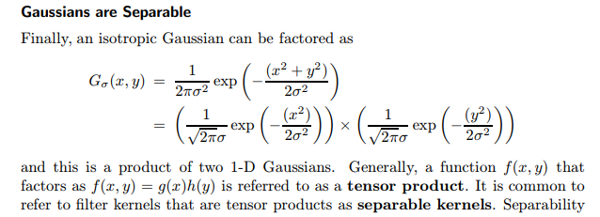
The Central Limit Theorem
With the associativity of convolution, this implies that if we choose a different smoothing kernel, and apply it repeatedly to the image, the result will eventually look as though we had smoothed the image with a Gaussian anyhow

Slide 54
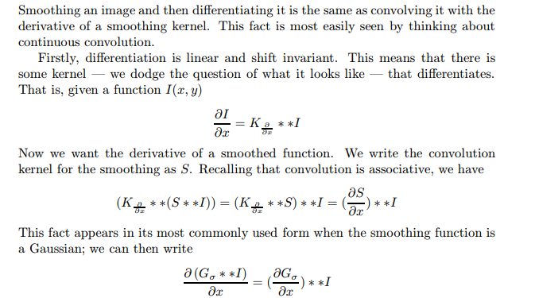
Derivative of Gaussian Filters

Slide 55
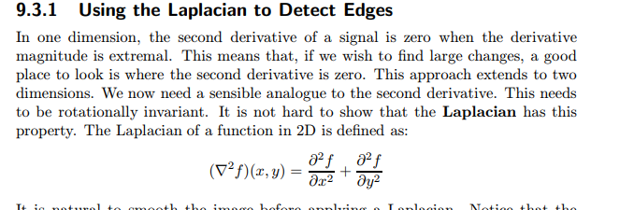
8. Detecting Edges
The two main strategies for detecting edges both model edges as very fast changes in brightness. In the first, we observe that the fastest change occurs when a 2D analogue of the second derivative vanishes.
The alternative is to explicitly search for points where the magnitude of the gradient is extremal

Slide 56
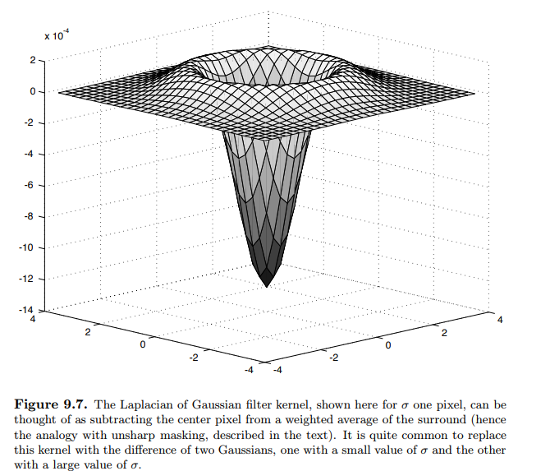
This leads to a simple and historically important edge detection strategy, illustrated in figure 9.8. We convolve an image with a Laplacian of Gaussian at some scale, and mark the points where the result has value zero — the zero crossings. These points should be checked to ensure that the gradient magnitude is large

Slide 57
Gradient Based Edge Detectors
In a gradient based edge detector, we compute some estimate of the gradient magnitude — almost always using a Gaussian as a smoothing filter — and use this estimate to determine the position of edge points.

Slide 58
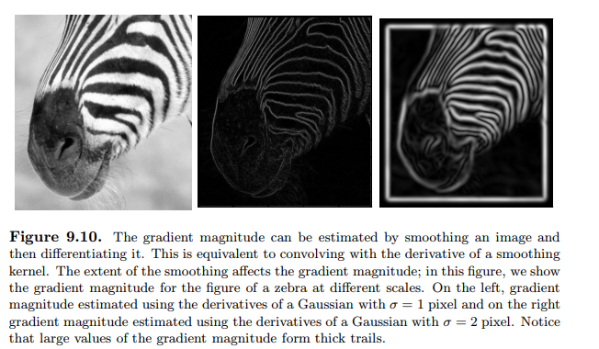

Slide 59
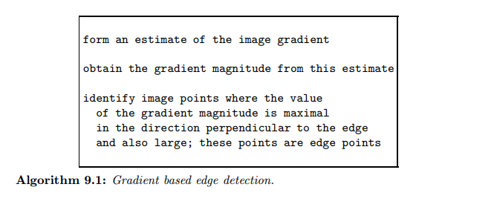

Slide 60
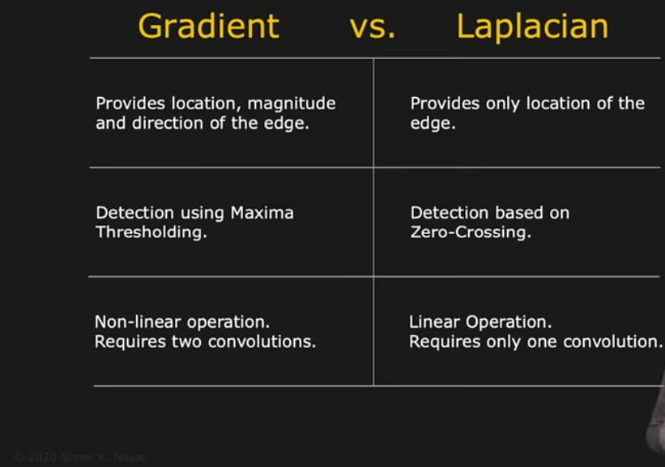

Slide 61
9. Texture:Representing Texture
Texture is a phenomenon that is widespread, easy to recognise and hard to define.
A leaf that occupies most of an image is an object, but the foliage of a tree is a texture. Texture arises from a number of different sources. Firstly, views of large numbers of small objects are often best thought of as textures. Examples include grass, foliage, brush, pebbles and hair. Secondly, many surfaces are marked with orderly patterns that look like large numbers of small objects. Examples include: the spots of animals like leopards or cheetahs; the stripes of animals like tigers or zebras; the patterns on bark, wood and skin

Slide 62
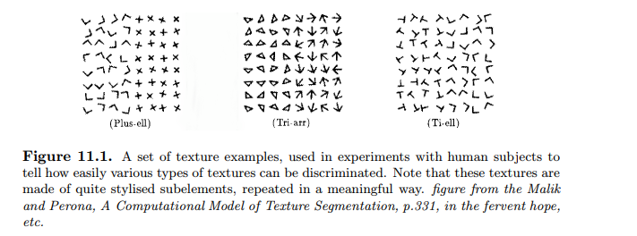

Slide 63
1.There are three standard problems to do with texture: •
Texture segmentation is the problem of breaking an image into components within which the texture is constant. Texture segmentation involves both representing a texture, and determining the basis on which segment boundaries are to be determined.
2. Texture synthesis seeks to construct large regions of texture from small example images. We do this by using the example images to build probability models of the texture, and then drawing on the probability model to obtain textured images. There are a variety of methods for building a probability model.
3.Shape from texture involves recovering surface orientation or surface shape from image texture. We do this by assuming that texture “looks the same” at different points on a surface; this means that the deformation of the texture from point to point is a cue to the shape of the surface

Slide 64
Representing Texture
Image textures generally consist of organised patterns of quite regular subelements (sometimes called textons). For example, one texture in figure 11.1 consists of triangles. Similarly, another texture in that figure consists of arrows. One natural way to try and represent texture is to find the textons, and then describe the way in which they are laid out.

Slide 65
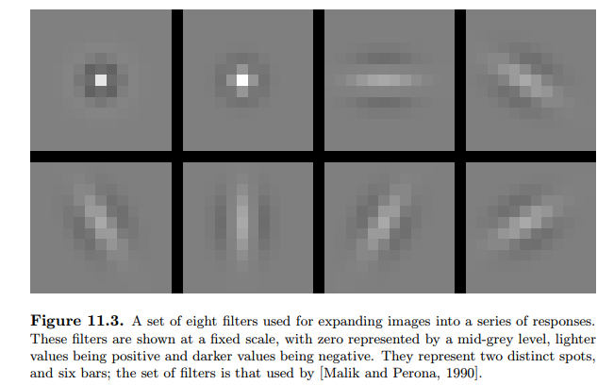
Extracting Image Structure with Filter Banks

Slide 66
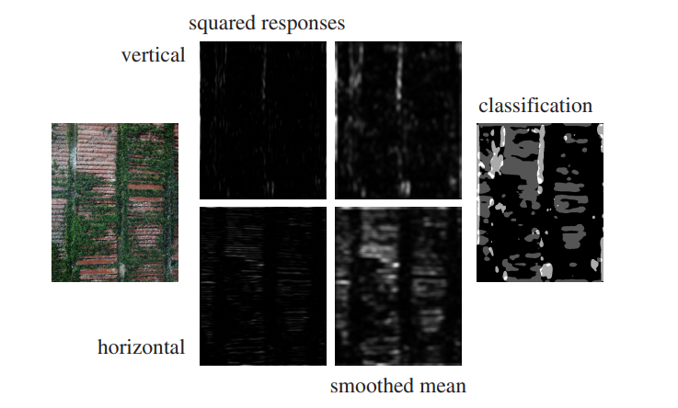
10.Analysis (and Synthesis )using oriented pyramids
the Gaussian pyramid is a highly redundant representation because each layer is a low pass filtered version of the previous layer — this means that we are representing the lowest spatial frequencies many times.
We need keep only a record of the errors in the prediction. This is the motivating idea behind the Laplacian pyramid.

Slide 67
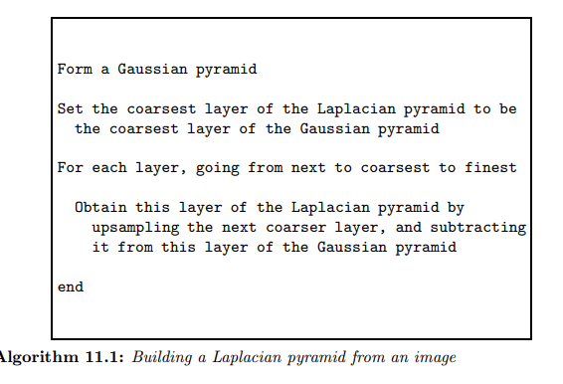

Slide 68
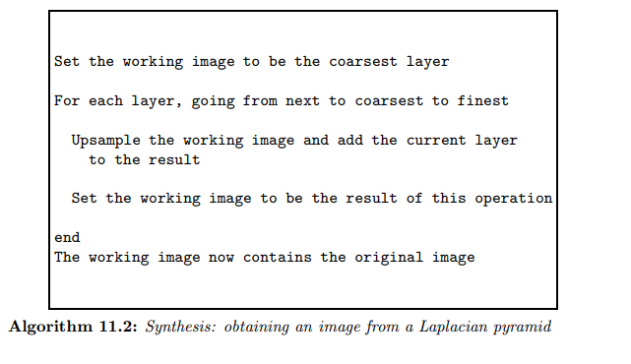

Slide 69
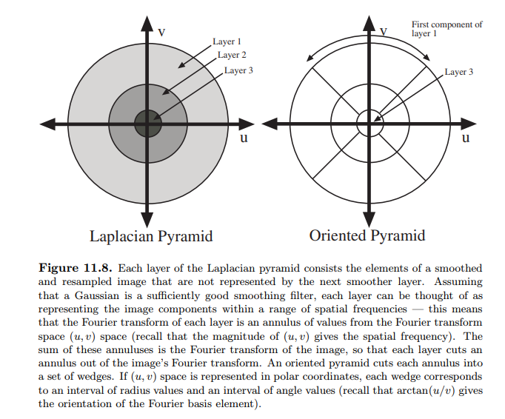
10. Analysis (and Synthesis )using oriented pyramids

Slide 70
Oriented Pyramids
A Laplacian pyramid does not contain enough information to reason about image texture, because there is no explicit representation of the orientation of the stripes. A natural strategy for dealing with this is to take each layer and decompose it further, to obtain a set of components each of which represents a energy at a distinct orientation. Each component can be thought of as the response of an oriented filter at a particular scale and orientation. The result is a detailed analysis of the image, known as an oriented pyramid

Slide 71
pyramid as an image, and the problem of adjusting a layer becomes the following. We have two images, and we should like to adjust image two so that it has the same histogram as image one. The process is known as histogram equalization

Slide 72
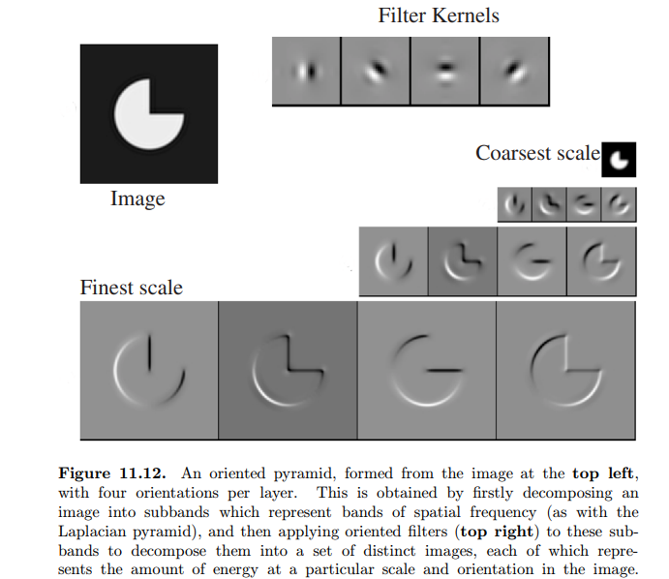

Slide 73
11Application:Synthesis by Sampling Local Models
To obtain a probability model for the value of that pixel, we could match a neighborhood of the pixel to the example image. Every matching neighborhood in the example image has a possible value for the pixel of interest. This collection of values is a conditional histogram for the pixel of interest. By drawing a sample uniformly and at random from this collection, we obtain the value that is consistent with the example image.

Slide 74
Finding Matching Image Neighbourhoods
The similarity between two image neighbourhoods can be measured by forming the sum of squared differences of corresponding pixel values. This value is small when the neighbourhoods are similar, and large when they are different
Synthesizing Textures using Neighbourhoods
One way to obtain a collection of examples for the pixel of interest is to count only the known values in computing the sum of squared differences, and to adjust the threshold

Slide 75
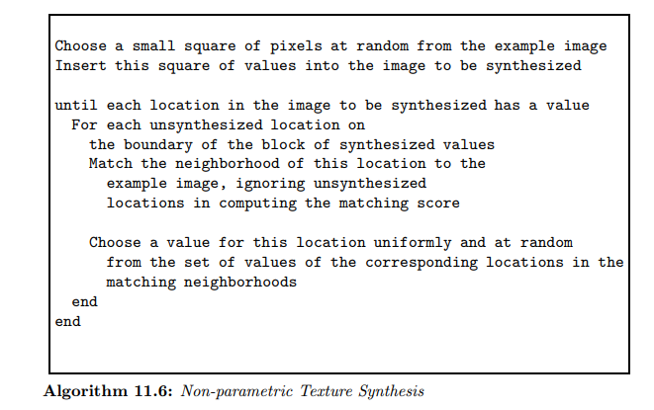

Slide 76
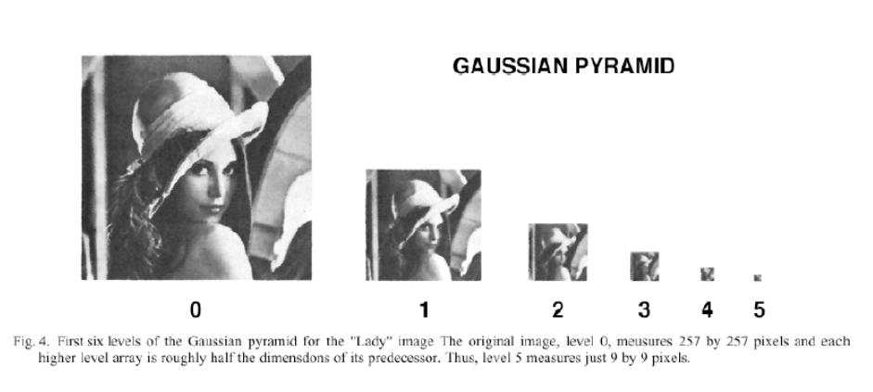

Slide 77
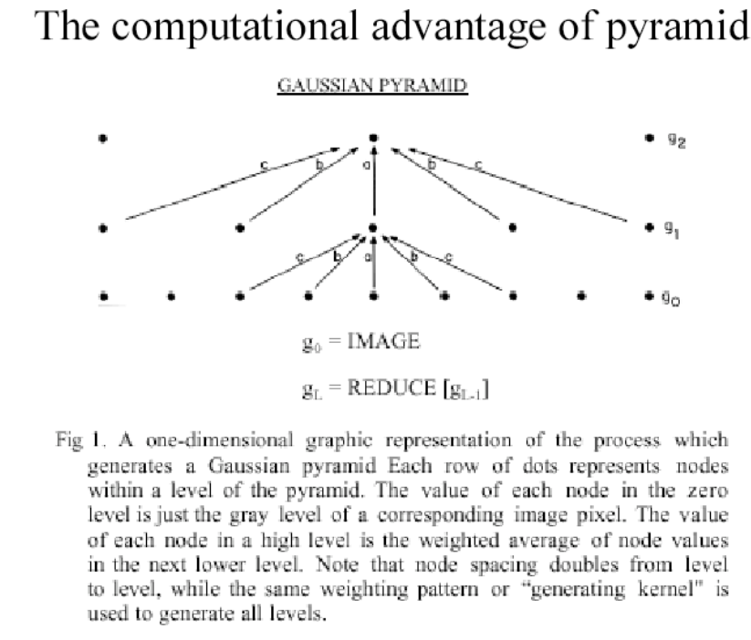

Slide 78
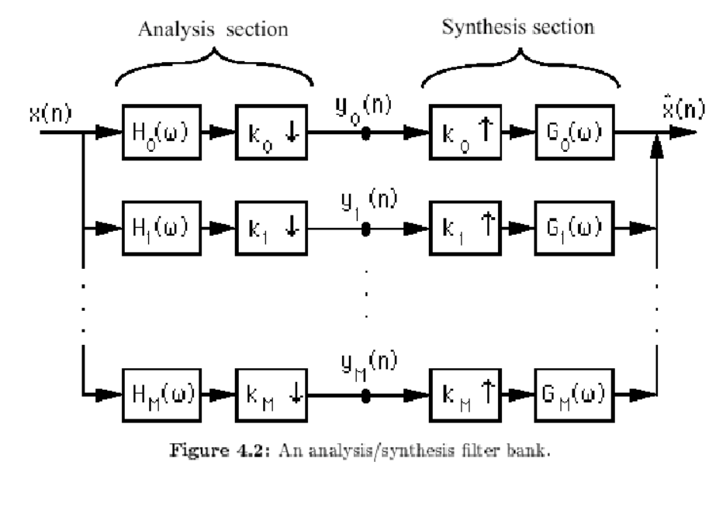

Slide 79
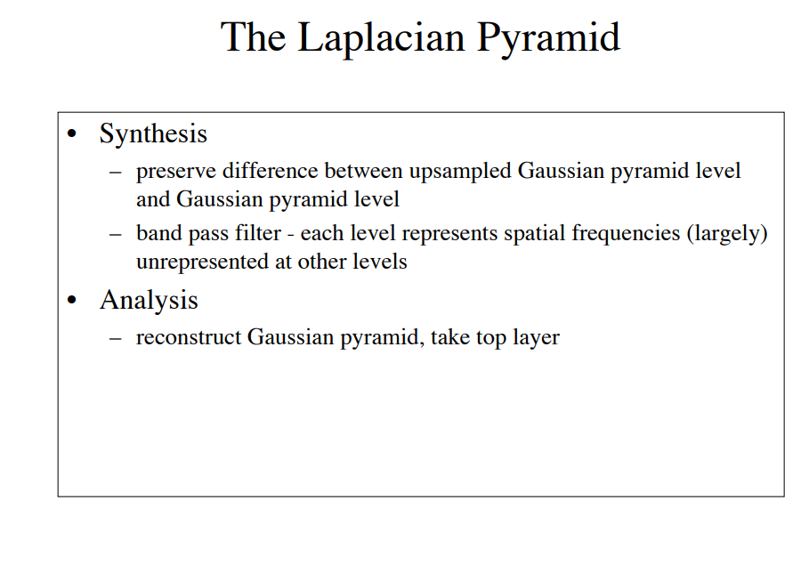

Slide 80
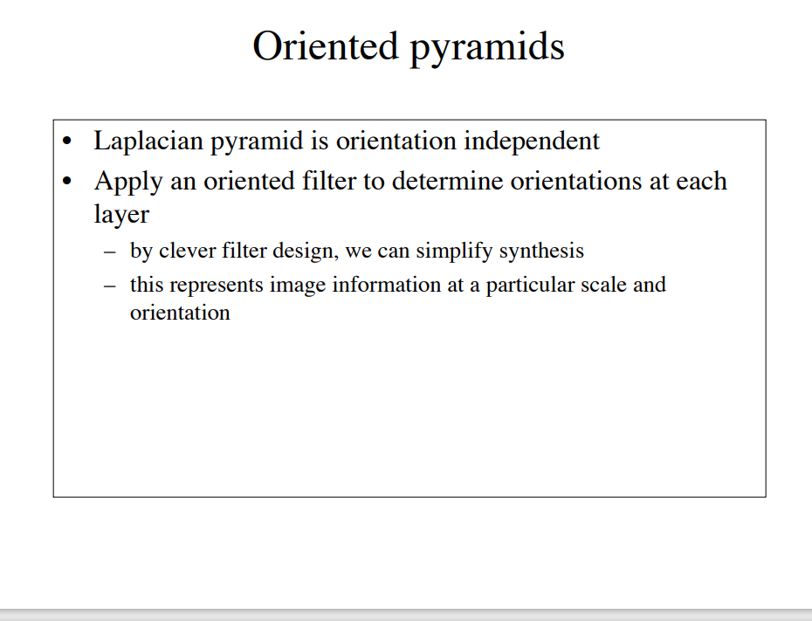

Slide 81
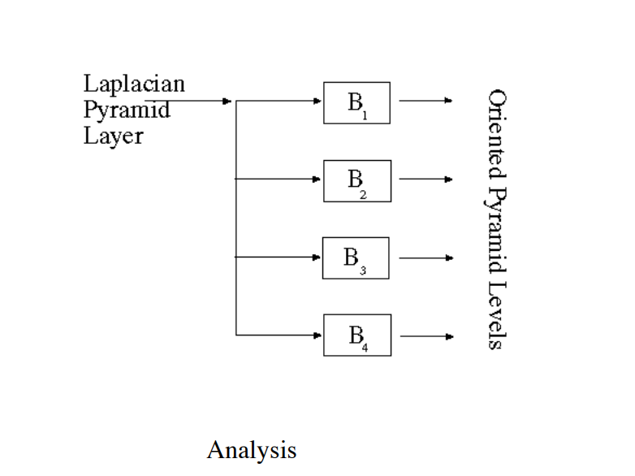

Slide 82


Slide 83


Slide 84
12. Shape from Texture
A patch of texture of viewed frontally looks very different from a same patch viewed at a glancing angle, because foreshortening causes the texture elements (and the gaps between them!) to shrink more in some directions than in others. This suggests that we can recover some shape information from texture, at the cost of supplying a texture model

Slide 85


Slide 86

Now assume that we are viewing a single textured plane in an orthographic camera. Because the camera is orthographic , there is no way to measure the depth to the plane. However, we can think about the orientation of the plane.

Slide 87
Isotropy Assumptions
An isotropic texture is one where the probability of encountering a texture element does not depend on the orientation of that element.

Slide 88


Slide 89

Shape from Texture for Curved Surfaces

Slide 90
Global methods attempt to recover an entire surface model, using assumptions about the distribution of texture elements. Appropriate assumptions are isotropy.
Local methods recover some differential geometric parameters at a point on a surface

